Slide 1
SIGNS WITH SMART CONNECTIVITY FOR BETTER ROAD SAFETY
HARRISHKUMAR S V 2004201
KUMARESH V 2004202
NOWTHAM M 2004203
SETTU S DINESH 2004205

Slide 2
OBJECTIVE
This project proposes a system which has digital sign boards on which the signs can be changed dynamically.
To efficiently manage the signs according to the situation or the area of presence.
2

Slide 3
NEED FOR THE PROJECT
The sign boards, that display the same information every time are not apt to the situation around them.
So they need to be made dynamical, by which we can manage the information provided on them likely time , weather – basis and etc.,
For example, considering a scenario, where we need to alert the driver to limit the speed of their vehicles, while passing the school zone at the particular time intervals (starting, ending of schools).
For this purpose, the dynamical sign board can be used efficiently by managing them on time – basis.
3

Slide 4
EXISTING SOLUTION
The existing sign boards system that are on road sides are static and they alert the driver every time with the same information provided on them.
The existing sign boards in some areas are of damaged condition, which leads to miscommunication with the user.
4

Slide 5
LITRETURE SURVEY
S.NO | TITLE | MODEL / TECHNIQUES USED | MERITS/ DEMERITS | OUTCOMES
1. | Songkran Kantawong “Smart Solar Cell e-Warning Signs Board via on Cloud based Control for Social Distancing Alert” (2021), Bangkok University. | RGB Led boards Solar power NETPIE Cloud Database | MERITS: Power Saving Smart Connectivity Cloud Based Model | A long distance access control is established especially for social distancing policy caused by COVID-19
2. | Devershi Pallavi Bhatt, Manish Tiwari “Smart Traffic Sign Boards (STSB) for Smart Cities” (2019), University of Bahrain. | STSB UHF - RFID | MERITS: Economical Easy Connectivity | Intelligent traffic management and driving assistance for the new driver for a particular area or city
5

Slide 6
LITRETURE SURVEY
S.NO | TITLE | MODEL / TECHNIQUES USED | MERITS/ DEMERITS | OUTCOMES
3. | Chetan Dhule et al.,“Study of Design of IoT based Digital Board for Real Time Data Delivery on National Highway” (2021), Electronics and Telecommunication Engineering Department, G H Raisoni College of Engineering, Nagpur. | Led based digital boards, Weather based, Solar power, Cloud, Database | MERITS: Smart Connectivity Cloud Based Model, | The proposed system is very powerful and very beneficial for travelers
4. | Jian L & Bin C (2009), "Research of Road Traffic Signs and Markings System Based on GIS". In 2009 Second International Conference on Intelligent Computation Technology and Automation (Vol. 3, pp. 694-697). | GIS sensors manages is to ensure the road safety with smooth of traffics. | MERITS: Improve the labor efficiency Reduce resource waste. | It help traffic department innovate manage and technology
6

Slide 7
INFERENCE
Information provided on the static sign boards cannot be changed easily, it must be re-established. Hence the cost goes high.
Static sign boards cannot be managed according to the situations.
Usage of IoT platform leads to the efficient indication system.
7

Slide 8
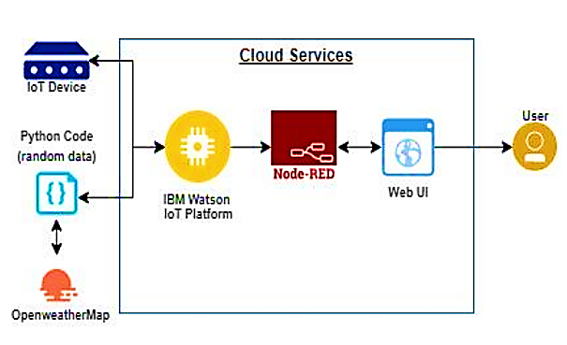
PROPOSED MODEL
8

Slide 9
REFERENCES
Songkran Kantawong “Smart Solar Cell e-Warning Signs Board via on Cloud based Control for Social Distancing Alert” (2021), Bangkok University.
Devershi Pallavi Bhatt, Manish Tiwari “Smart Traffic Sign Boards (STSB) for Smart Cities” (2019), University of Bahrain.
Chetan Dhule et al., “Study of Design of IoT based Digital Board for Real Time Data Delivery on National Highway” (2021), Electronics and Telecommunication Engineering Department, G H Raisoni College of Engineering, Nagpur.
Jian L & Bin C (2009), "Research of Road Traffic Signs and Markings System Based on GIS". In 2009 Second International Conference on Intelligent Computation Technology and Automation (Vol. 3, pp. 694-697).
Yasir Mehmood (et al) “Internet-of-Things Based Smart Cities: Recent Advances and Challenges”,(2017) IEEE Communications Magazine Volume: 55 Issue: 9, pp. 16 – 24.
Kumari, Neha, Shivani Gosavi, and Sandeep S. Nagre. "Real-Time Cloud based Weather Monitoring System." (2020) 2nd International Conference on Innovative Mechanisms for Industry Applications (ICIMIA) IEEE.
9

